Slide 1
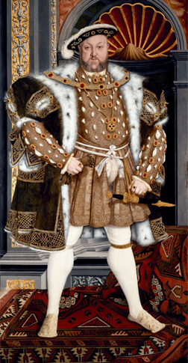
The Renaissance and Reformation (1300–1650)
Lesson 4 Reformation Ideas Spread

Slide 2
The Renaissance and Reformation (1300–1650)
Topic 4 Lesson 4 Reformation Ideas Spread
Key Terms
sects
Henry VIII
Mary Tudor
Thomas Cranmer
Elizabeth
canonized
compromise
Council of Trent
Ignatius of Loyola
Teresa of Avila
ghetto

Slide 3
The Renaissance and Reformation (1300–1650)
Topic 4 Lesson 4 Reformation Ideas Spread
Learning Objectives
Describe the new ideas that Protestant sects embraced.
Understand why England formed a new church.
Analyze how the Catholic Church reformed itself.
Explain why many groups faced persecution during the Reformation.
Explain the impact of the Reformation.

Slide 4
An Explosion of Protestant Sects
Radical Reformers
Hundreds of Protestant sects will form
Some are similar to Luther or Calvin or another reformer Ulrich Zwingli
Anabaptists reject the idea of infant baptism. They feel adults should be baptized because they understand what it means
Anabaptists also call for religious tolerance when there is a lot of religious intolerance
Today Baptists, Mennonites, and the Amish all can trace their ancestry to Anabaptists

Slide 5
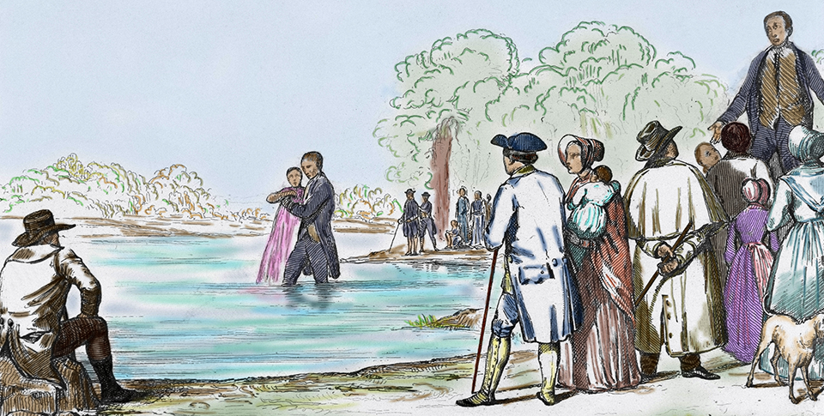
An Explosion of Protestant Sects
Anabaptists practiced adult baptism. Often, the ceremony took place in a river, pond, or similar body of water.

Slide 6
The English Reformation
Henry VIII Seeks an Annulment
Pope had called Henry VIII Defender of the Faith for denouncing Luther.
Henry had married Catherine of Aragon from Spain and has a daughter Mary Tudor. He feels like he needs a son so he wants an annulment from his marriage.
The Pope refuses b/c she is the niece of Charles V of Germany, the Holy Roman Emperor
Henry VIII Breaks with the Church
Henry is furious and has a series of laws passed to put him at the head of the English Church. In 1534 the Act of Supremacy passes
Once his marriage is annulled he marries Anne Boleyn and has a daughter Elizabeth.
He marries 4 more times but only has one son, Edward
Many Catholics refuse to accept the Act of Supremacy and are executed, including Sir Thomas More. Later he will be a saint

Slide 7
The English Reformation
The Church of England
1536-1540 Henry VIII closes all the monasteries and takes their land and wealth for the crown
He will give lands to nobles to support the new Church of England
Henry is not radical, he will keep most Catholic forms of worship
Religious Turmoil
When Henry dies Edward takes the throne and introduces the Book of Common Prayer. It causes an uproar b/c its Protestant
Edward dies and his sister Mary Tudor inherits. She’s Catholic and tries to bring England back but fails. However hundreds of Englishmen are burned at the stake for heresy including the archbishop who annulled her mother’s marriage to Henry
The Elizabethan Settlement
When Elizabeth rules she will enforce reform that both Protestant and Catholics can accept, use English for Church, keep most Catholic ritual, and kept the monarchy as the head of the Church

Slide 8
The English Reformation
This portrait of King Henry VIII of England was painted by the famous court artist, Hans Holbein. Henry broke with the Catholic Church over differences concerning his marriage to Catherine of Aragon.

Slide 9
The Catholic Reformation
The Council of Trent Passes Reforms
Will meet over 20 years. Will provide stiff penalties for clergy corruption. Will also establish schools to better educate priests they can challenge Protestant teachings
The Inquisition Is Strengthened
Will use secret testimony, torture, and execution to root out heresy. It will also have An Index of Forbidden Books, a list of works considered too immoral for Catholics to read
The Jesuits
Founded in 1540 by Ignatius of Loyola the order was created to combat heresy and spread the Catholic faith
Become advisors to kings, set up schools to teach humanist and catholic beliefs, went into Protestant countries to minister Catholics, spread Catholicism to Asia, Africa, and the Americas

Slide 10
The Catholic Reformation
Teresa of Avila
Born into a wealthy Spanish family, Teresa joins a convent for nuns but finds it not strict enough.
She creates her own order of nuns, impressing her superiors. She is then asked to reform Spanish monasteries and convents
She is made a saint for her work
Results of the Catholic Reformation
Majority of Europeans were still Catholic
Church abuses were reduced from within
Some protestant areas went back to Catholicism but there will still be a divided Europe with a Catholic south and a Protestant north

Slide 11
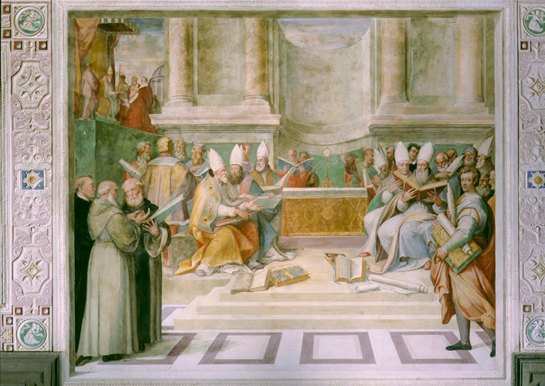
The Catholic Reformation
Pope Paul III meets with Catholic religious leaders at the Council of Trent, where he called for a series of reforms to correct abuses within the Church.

Slide 12
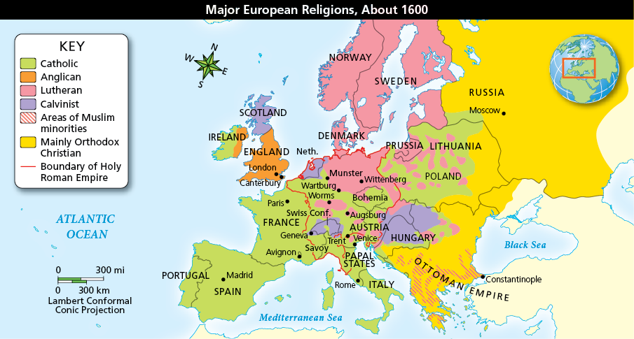
The Catholic Reformation
Analyze Maps By 1600, the spread of Protestantism had transformed Catholic Europe. What was the main religion in France? Why were most people in each region practicing that religion by 1600?

Slide 13
Religious Persecution Continues
Witch Hunts
B/w 1450-1750 tens of thousands died as victims of witch hunts
People saw a link between magic and heresy so anyone who was believed to have magic was also to be in league with the devil
Most witch hunts occurred in areas of religious conflict like the German states, Switzerland, and France
Persecution of Jews
In the early Ren Jews in Italy were allowed to stay and prosper unlike the Spanish Jews
By 1516 Jews in Venice are being moved into a separate quarter of the city called the ghetto. Other Italian cities will follow
Luther will hope the Jews will convert but when they don’t he will call for their synagogues to be burned and for them to be exiled
Some German princes will expel Jews, other will force them into ghettos or wear a yellow star to travel outside the ghetto

Slide 14
Religious Persecution Continues
Because the Pope stops the lenient policy of before Jews will migrate to Poland-Lithuania and the Ottoman empire.
Dutch Calvinist will also take in Jews expelled from Spain and Portugal

Slide 15
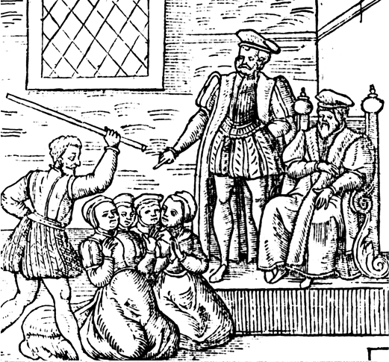
Religious Persecution Continues
Women accused of witchcraft are questioned before King James. Many women who were skilled with herbs or seen as being different from the norm were suspected of witchcraft. Men also fell victim to the persecution, fed by religious fervor.

Slide 16
Quiz: An Explosion of Protestant Sects
What was the one key belief shared by the different Anabaptist sects?
A. Only adults should be baptized.
B. Property should be distributed equally among all people.
C. There should be a state religion.
D. Violent protest was the best way to quickly achieve social change.

Slide 17
Quiz: The English Reformation
What was the main catalyst driving Henry VIII to establish the Church of England?
A. He wanted to strengthen the economy by dissolving the monasteries and using their lands and money for the English treasury.
B. The pope had offended Henry by refusing to recognize his efforts in defending the Catholic faith against Martin Luther.
C. He was a staunch Protestant and wanted to break away from the traditions, rituals, and hierarchy of the Roman Catholic Church.
D. The pope would not grant him an annulment so he could remarry and produce a male heir to succeed him.

Slide 18
Quiz: The Catholic Reformation
What was one of the important results of the Catholic Reformation?
A. The Roman Catholic Church met at the Council of Trent and reaffirmed traditional doctrine, took steps to end abuses, and established new schools.
B. The Roman Catholic Church, through its work at the Council of Trent, completely stopped the spread of Protestantism in Europe.
C. The Roman Catholic Church met at the Council of Trent and incorporated most of Martin Luther’s teachings into its doctrine.
D. The Roman Catholic Church and the main Protestant sects met at the Council of Trent to establish a spirit of cooperation and new schools to educate the clergy.

Slide 19
Quiz: Religious Persecution Continues
The ghetto in Venice was an example of how
A. there was greater tolerance for Jewish populations.
B. Christians were willing to have Jews live among them.
C. restrictions on the Jewish community increased.
D. efforts to convert Jews to Christianity increased.

